Slide 1

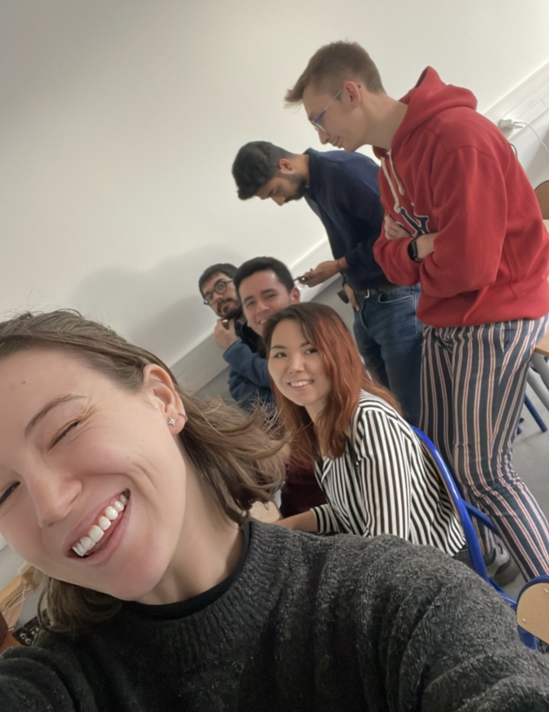
PROJECT CHART
PROJECT NAME: Eta by WaterChess Team 20
OBJECTIVE
Description
TEAMS
Raise awarness on energy consumption and provide easy solutions to save money and energy to French single houses owners.
Meet Eta, the app that will change the way you save.
Through our Machine Learning model, Eta will accurately predict your household energy consumption. Eta will then help you understand the impact of renovating certain house features, quantify the energy and monetary savings of those changes and guide you towards the closest renovating companies.
Stefano Bavaro : ML Model - M1- AI – Université Paris Saclay
Matteo Facta: Business Pitch, Market Research, Finance – M1 – MiM Grande Ecole – HEC Paris
Thanh Gia Hieu Khuong: ML Model - M1- AI – Université Paris Saclay
Benedetta Magni: Business Pitch, Video makign and editing, Finance, Market research - M1 – MiM Grande Ecole – HEC Paris
Diego Torres: ML Model - M1- AI – Université Paris Saclay
Dana Zhumabekova: ML Model - M2 ROSP - Réseaux Optiques and Systèmes Photonique - IP Paris
Mahdi Ranjbar: ML Model - M1- AI – Université Paris Saclay
We will partner with the French State, and through an initial investment in marketing techniques such as TV ads, Instagram and Facebook content and mailing lists, we will reach out to French single home owners who will be able to download the Eta App for free.
As they undertake renovations, the French state will pay us a fixed fee of 200€ per renovation.
Most home owners are not aware of their energy consumption and of the potential energy savings they could realize by using optimal technologies such as double-glazed windows or newer insulation technologies. By using our user-friendly, personalized and interactive app, they will be able to understand the potential monetary savings involved with renovations and thus be incentivized to renovate their homes. As such, we will help the French State reach its housing renovation goal to improve overall energy efficiency in the housing sector.
Notes:
Ghita

